Slide 1

CONTAINERS
vs.
SERVERLESS
from a DevOps
standpoint

Slide 2
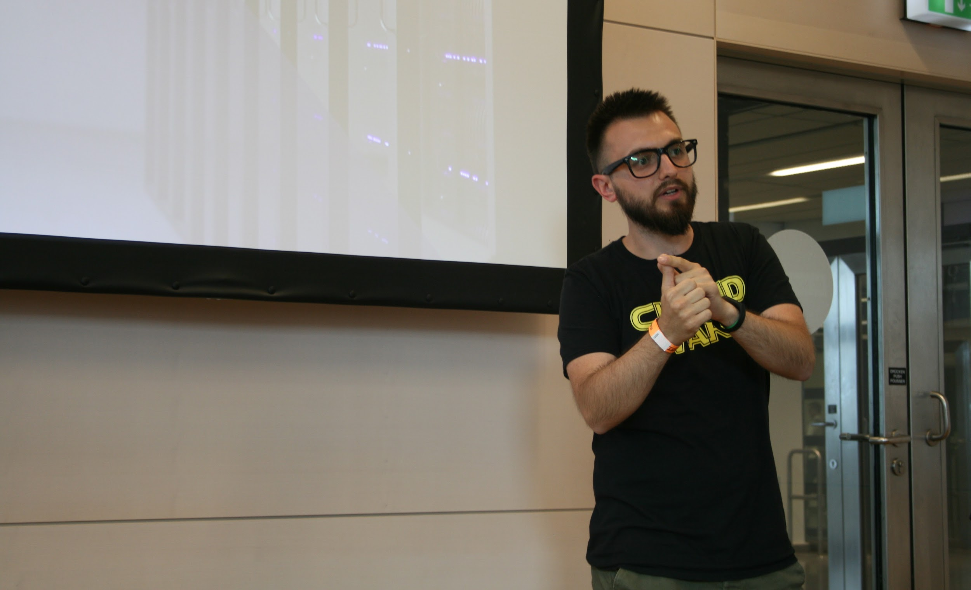

WHO AM I?
I’m Adnan Rahić
- Developer Advocate at - Teaching people to code since 2016 - Tech Writer on Medium - Author of “Serverless JavaScript by Example”
( there will be a free giveaway at the end - stay tuned 😁 )

Slide 3
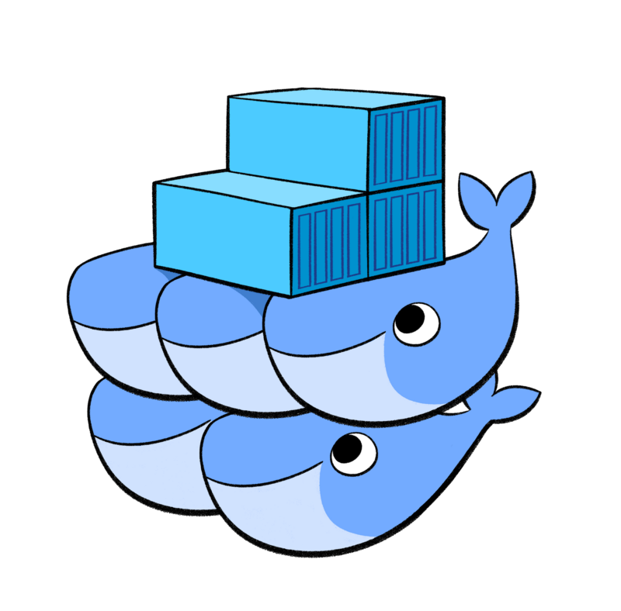
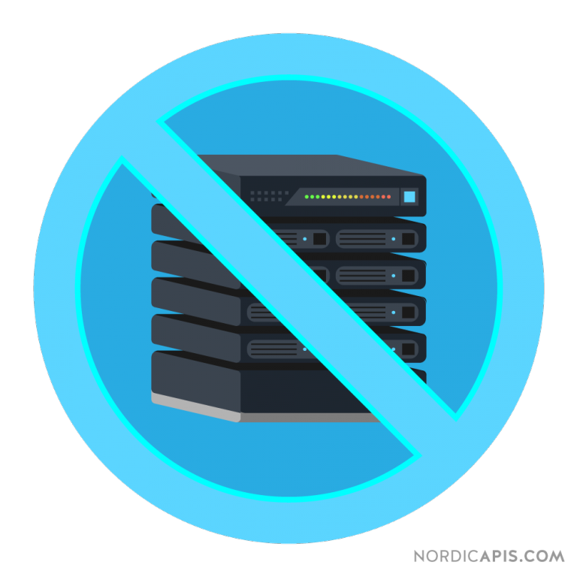
WHAT WILL WE BE TALKING ABOUT TODAY?
vs.
PS: I think we all know serverless still uses servers, and no, there will be no pictures of boats in this presentation.
Notes:
In short - we’ll talk about the upsides and downsides of both technologies
The longer explanation is that we will go over all the pros and cons of using container as well as all the pros and cons of using serverless
I want you to get a perspective of when it’s good to use something versus when it should be avoided

Slide 4
AGENDA
What are containers?
Container pros/cons & use cases
Container live DevOps session
What is serverless?
Serverless pros/cons & use cases
Serverless live DevOps session
vs.

Slide 5
WHAT ARE CONTAINERS?
Isolated, stateless environment
Abstracting infrastructure
Like a tiny VM, but not really

Slide 6
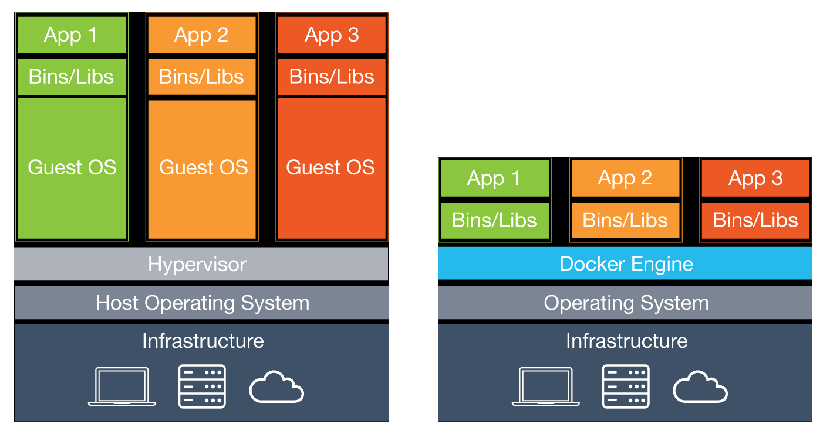
WHAT ARE CONTAINERS?
Each VM needs a separate OS
Containers share host OS kernel

Slide 7
CONTAINER CONS
Does not auto-scale
Harder to deploy
Steep learning curve
More complex with more moving parts
More expensive

Slide 8
CONTAINER PROS
Full control
Almost infinite scalability
Easy debugging/monitoring
Easy collaboration (unified environment)

Slide 9
CONTAINER USE-CASES
Monoliths
Microservices
Web APIs
Long running processes
Data science

Slide 10
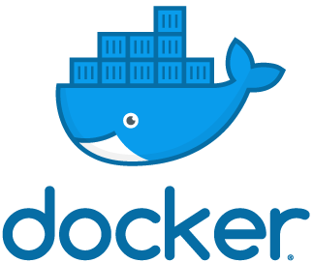

+
LIVE DEVOPS SESSION #1!
Deploying a container
to an AWS cluster with Docker Swarm

Slide 11

WHAT IS SERVERLESS?
Function as a Service (FaaS)
Event based system for running code
We don’t care about servers - only the code
Abstracting away the infrastructure

Slide 12
SERVERLESS CONS
Defined limits (memory, cpu, execution time)
Risk of overloading system
Bad monitoring/debugging solutions
Latency

Slide 13
SERVERLESS PROS
Pay for how much you use
Low maintenance
Simple & Easy to deploy
Auto-scaling
Faster time-to-market

Slide 14
SERVERLESS USE-CASES
Web APIs
Process data streams, images etc
Short running processes
Periodic processes / cron

Slide 15
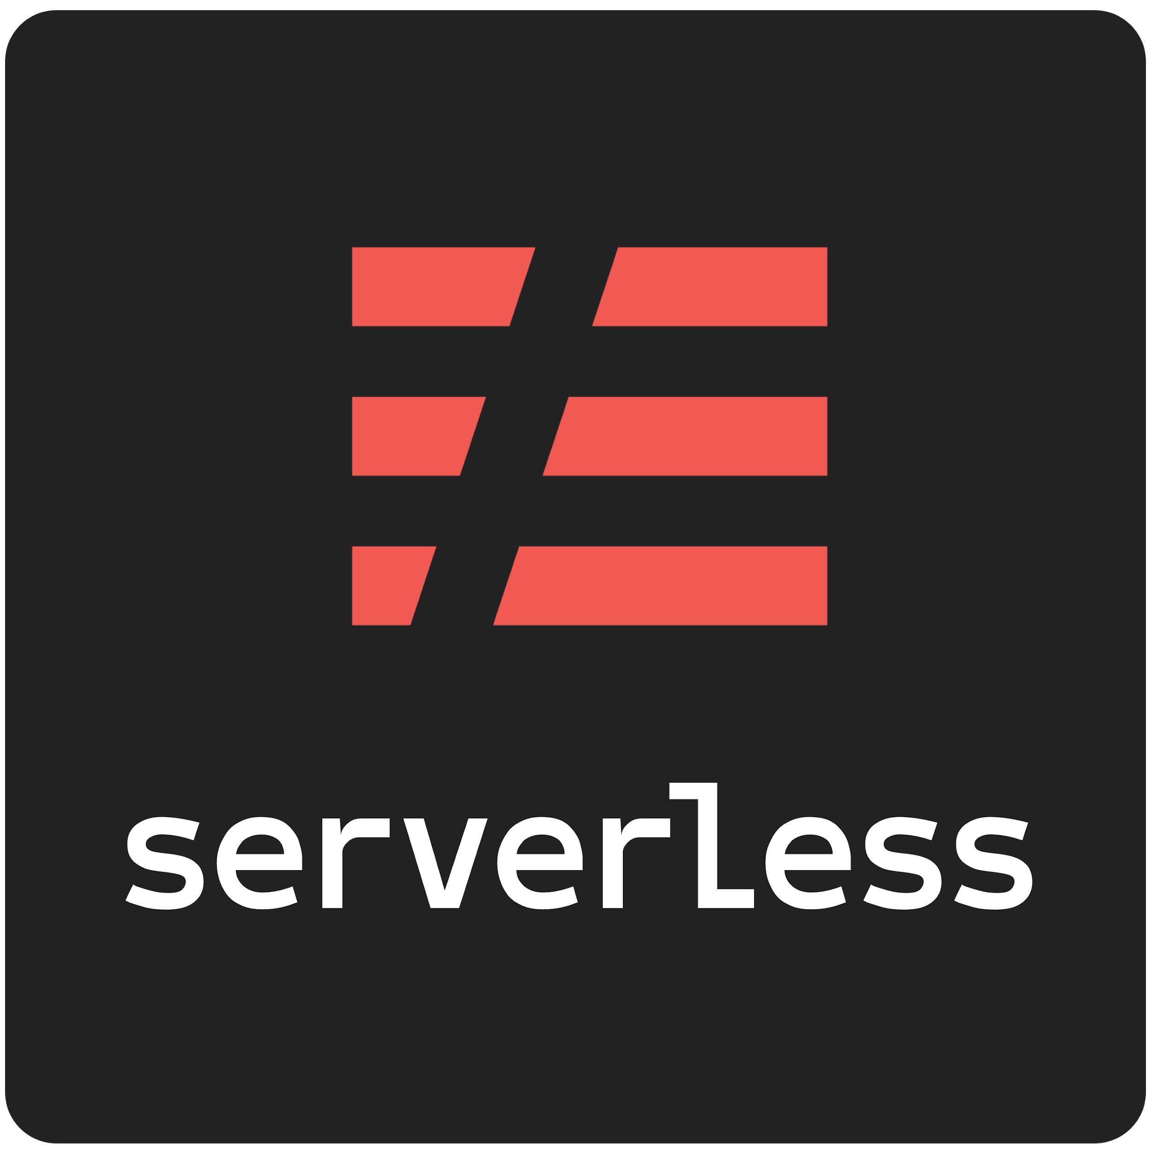
LIVE DEVOPS SESSION #2!
Deploying a serverless app
to AWS Lambda with
the Serverless Framework
+
Notes:
Create new sls project
Explain we need to install npm modules -> express, serverless-http, serverless-offline
Open serverless.yml -> configure for express -> explain proxies and how API GW will proxy all requests to the Express router
Open handler.js -> rename to app.js -> “let’s create a simple express app just like we’re used to...” -> add simple express code with app.listen() -> add serverless-http and refactor to sls -> explain how module.exports.server will be the actual Lambda
Run: sls deploy -> while deploying change to Dashbird -> explain how hard sls apps are to test and debug -> “because I’ve hooked up AWS acc to my Dashbird acc I can see all my functions, invocations and everything else I need to have an overview of my systems health. You can already see the invocations from the previous example” -> move back to terminal, show it is deployed
Test the endpoints
Show the live-tailing feature

Slide 16
THE VERDICT!
Containers
Flexibility
Control
Legacy migration
Serverless
Fast deployment & development
Auto-scaling
Lower cost

Slide 17
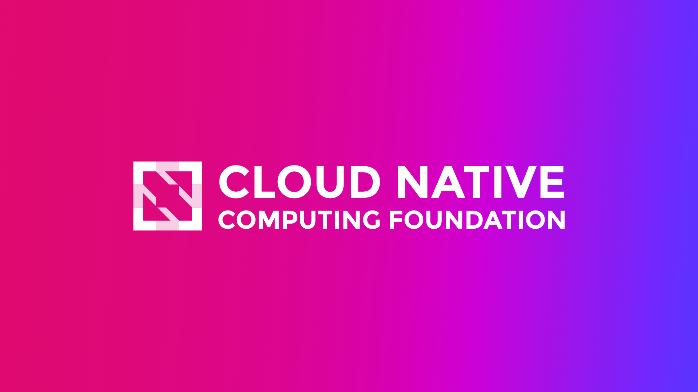
THANKS!
Any questions?
You can find me at
@adnanrahic on Medium, GitHub, Twitter, and LinkedIn!
adnan@dashbird.io

Slide 18
RESOURCES
Docker Swarm CloudFormation setup on AWS - https://docs.docker.com/docker-for-aws/#quickstart
Express app with Docker repo - https://github.com/adnanrahic/express-docker-app
Serverless setup tutorial - https://dev.to/adnanrahic/how-to-deploy-a-nodejs-application-to-aws-lambda-using-serverless-2nc7
Express app with Serverless repo - https://github.com/adnanrahic/express-sls-app

